Slide 1
Traffic Light and Sign Detection
Shelvin Pauly and Qamar Syed

Slide 2
Problem
Develop an algorithm to detect traffic signs and lights
Especially useful for autonomous driving
Speed is important! Red lights, stop signs, crosswalk signs, etc. must be detected quickly in order to prevent injury and possibly fatality

Slide 3
Background Material
CNN’s are commonplace in object detection and classification; especially for the purpose of autonomous driving
“Traffic Light Detection and Recognition for Self-Driving Cars Using Deep Learning” develops a CNN and uses it in conjunction with a region of interest algorithm to reduce processing time
CNN looks across only a few small squares instead of the entire image
R. Kulkarni, S. Dhavalikar and S. Bangar, "Traffic Light Detection and Recognition for Self-Driving Cars Using Deep Learning," 2018 Fourth International Conference on Computing Communication Control and Automation (ICCUBEA), 2018, pp. 1-4, doi: 10.1109/ICCUBEA.2018.8697819.

Slide 4
Flowchart
Prior to developing algorithm: Train deep learning model to detect and classify traffic lights and signs
Detect regions of interest for traffic lights and signs
Send regions of interest to the detection system using trained model
Overlay new images with bounding boxes on top of previous locations

Slide 5
Training
Used Yolov5 nano with the following datasets:
Tiny LISA Traffic Sign Dataset
LISA Traffic Light Dataset
Converted both to Yolov5 annotation format and trained
Used batch size of 32 and a low number of epochs for both
Note. YOLOv5 is a family of object detection architectures and models pretrained on the COCO dataset.
M. Lopez-Montiel, U. Orozco-Rosas, M. Sánchez-Adame, K. Picos and O. H. M. Ross, "Evaluation Method of Deep Learning-Based Embedded Systems for Traffic Sign Detection," in IEEE Access, vol. 9, pp. 101217-101238, 2021, doi: 10.1109/ACCESS.2021.3097969.
Jensen MB, Philipsen MP, Møgelmose A, Moeslund TB, Trivedi MM. Vision for Looking at Traffic Lights: Issues, Survey, and Perspectives. I E E E Transactions on Intelligent Transportation Systems. 2016 Feb 3;17(7):1800-1815. Available from, DOI: 10.1109/TITS.2015.2509509

Slide 6

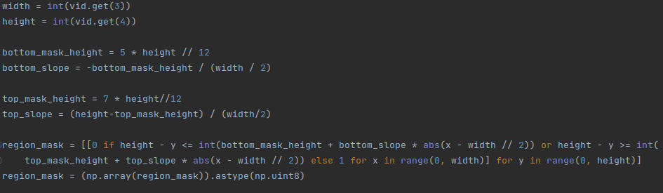
Traffic Sign and Light Boundaries
Selects top of the image as traffic lights are only found there
Ignores upper and lower triangle while looking for signs

Slide 7
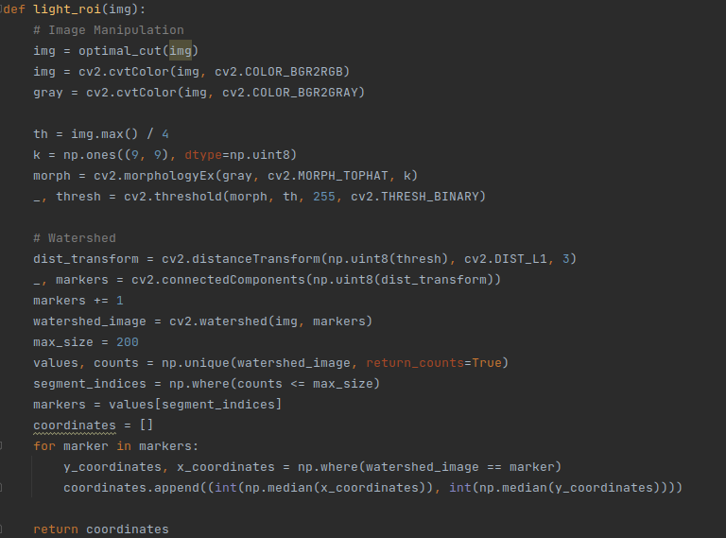
Traffic Light ROI
Uses multiple filters and then water shedding to obtain general color groups
Finds intense colored regions and returns them

Slide 8
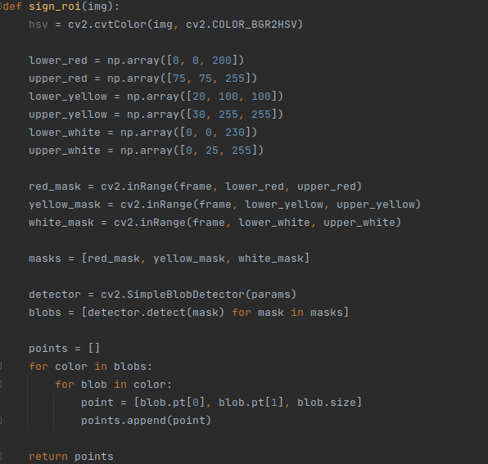
Traffic Sign ROI
Makes a mask for red, yellow, and white (traffic sign colors)
Searches for rectangular blobs in each mask and returns their coordinates and sizes

Slide 9
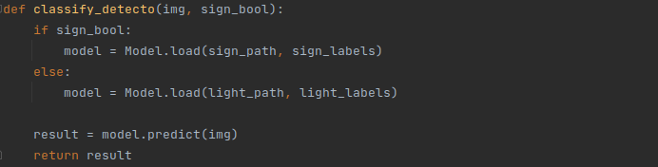

Trained Model Detection
Imports and uses trained Detecto model for Faster RCNN detection
Imports and uses trained Yolov5n model

Slide 10
Results - ROI with trained Model vs Yolov5 built-in model
Inference Speed:
Built-in: 73.6ms
ROI with trained model: 21.2ms
Detection:
Built-in model has pretty accurate detection of a wide variety of objects
Trained Yolov5 nano model is lacking in detection ability
Huge improvements could be made with an upgraded model such as Yolov5 small
Nano chosen to provide reasonable training times

Slide 11
Video Comparison

Slide 12
Conclusion and Lessons Learned
There is potential for using an trained object classifier such as Yolov5 in combination with a ROI algorithm to allow for real-time traffic light and sign detection
ROI algorithm + classifier resulted in a very low processing time
Accuracy is important as well however
Need to guarantee ROI can potentially allow empty squares, but does not miss any signs or lights
Much better model and training is required
Learned how to train a dataset using an object detection model
Need to use proper hardware and give adequate training time

